Slide 1
Submitted to: Md Imran Hossain Assistant Professor Department Of ICT Comilla University
Submitted by :
Prome Saha Resha
ID:11809048
Dept. Of ICT
Comilla University

Slide 2
Simplified Monochrome Television Transmitter

Slide 3
Monochrome Television :
Television in which the final reproduced picture is monochrome,
having only shades of gray between black and white.
Also known as black-and-white television.

Slide 4

Fig: Monochrome TV

Slide 5
Simplified Monochrome Television Transmitter:
A Monochrome Television Transmitter system is quite unlike any of the transmission systems studied previously.
This section will deal with the fundamental, “straightforward” blocks,
while the functions specific to Monochrome Television Transmitter

Slide 6
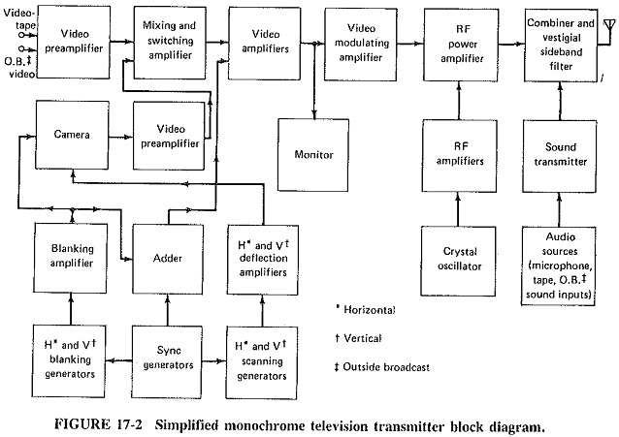

Slide 7
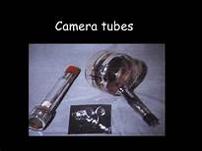
Camera tubes:

Slide 8
Very basically, a camera tube has a mosaic screen, onto which the scene is focused through the lens system of the television camera.
An electron gun forms a beam which is accelerated toward this photoelectric screen.
The beam scans the screen, from left to right and top to bottom, covering the entire screen 30 times per second.

Slide 9
Video Stages:
The output of the camera is fed to a video switcher which may also receive videotape or outside broadcast video signals at other inputs.
The function of this switching system is to provide the many video controls required.

Slide 10
Video Stages:
It is at this point that mixing or switching of the various inputs, such as fading in of one signal and fading out of another, will take place.
The output of this mixing and switching amplifier goes to more video amplifiers, whose function it is to raise the signal level until it is sufficient for modulation.

Slide 11
Video Stages:
These are the vertical and horizontal blanking and synchronizing pulses, which are required by receivers to control their scanning processes.
The final video amplifier is the power amplifier which grid-modulates the output RF amplifier.

Slide 12
Video Stages:
Because certain amplitude levels in the composite video signal must correspond to specific percentage modulation values, this amplifier uses clamping to establish the precise values of various levels of the signal which it receives.

Slide 13
RF and Sound Circuitry :
Essentially, the sound transmitter is a frequency-modulated transmitter of the type. The only difference is that maximum deviation is limited to 25 kHz, instead of the 75-kHz limit for FM broadcast transmitters.
The RF aspects of the picture transmitter are again identical, except that the output stage must be broad-band, in view of the large bandwidth of the transmitted video modulated signals.

Slide 14
The End

